Slide 1
LLM on a Toaster: II
Speed-ups & Fine-tuning
2025-03-28

Slide 2
Recap
NLP so far
Scaling to a trillion parameters
Compute Overhead on scaling down model size
Quantisation to improve memory usage
How to build a GPT-2 from scratch

Slide 3
LLMs on a Toaster
How can smol models compete?
Parameter-Efficient Fine-tuning
Speeding up Inference
Distillation

Slide 4
Parameter-Efficient Fine-tuning
Why?
Full fine-tuning is prohibitively expensive, especially for large models.
A single checkpoint of GPT3-175B is ~1TB.
Full fine-tuning multiple models, each for a different downstream task and deploying them separately is, again, prohibitively expensive.

Slide 5
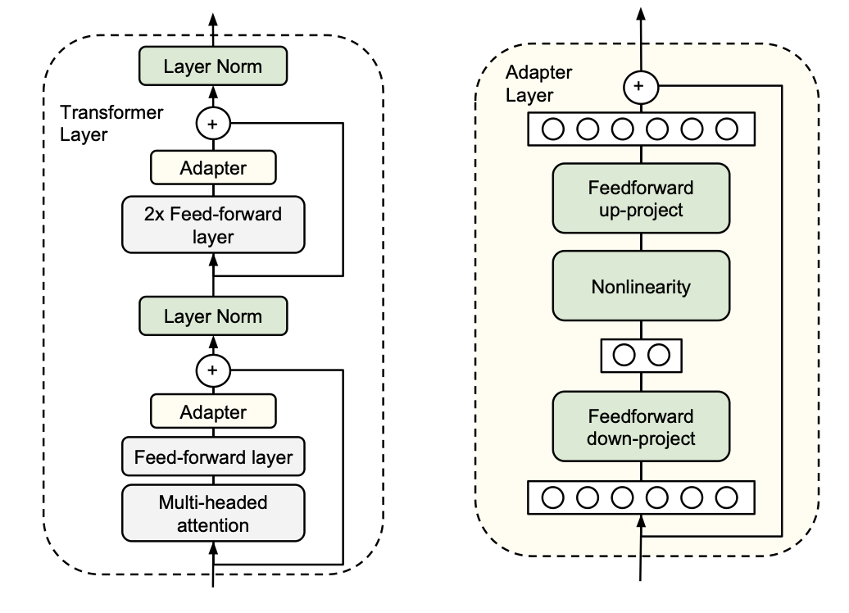
Parameter-Efficient Fine-tuning
Adapter Layers, Houlsby et al., 2019

Slide 6
Parameter-Efficient Fine-tuning
Adapter Layers, Houlsby et al., 2019
Adapters become a latency bottleneck during inference
Adapters are sensitive to initialisation
Adds extra compute requirements

Slide 7
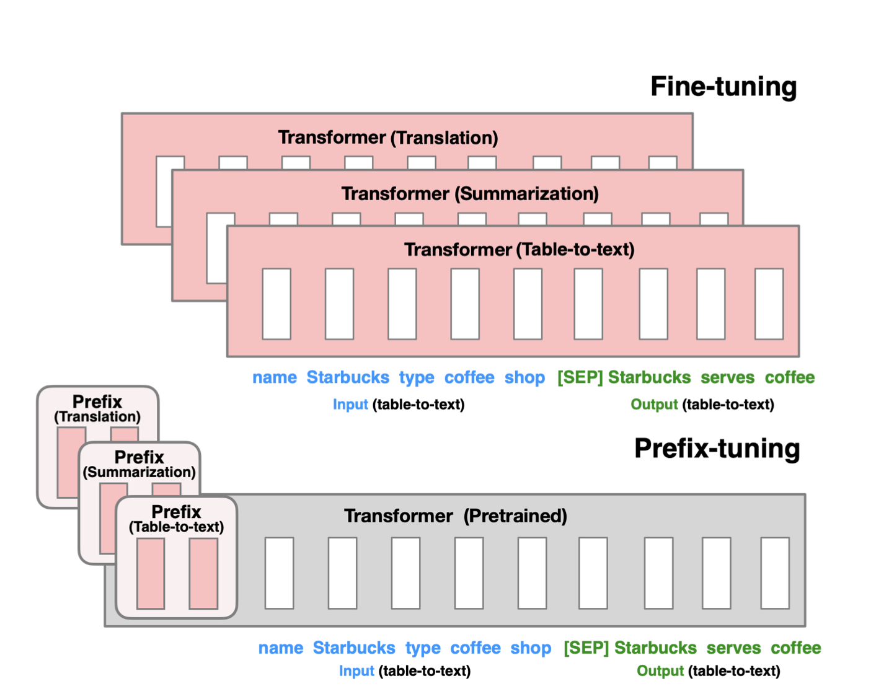
Parameter-Efficient Fine-tuning
Prefix Tuning, Li et al., 2021

Slide 8
Parameter-Efficient Fine-tuning
Prefix Tuning, Li et al., 2021
Difficult to optimise
Reduces sequence length available to downstream tasks

Slide 9
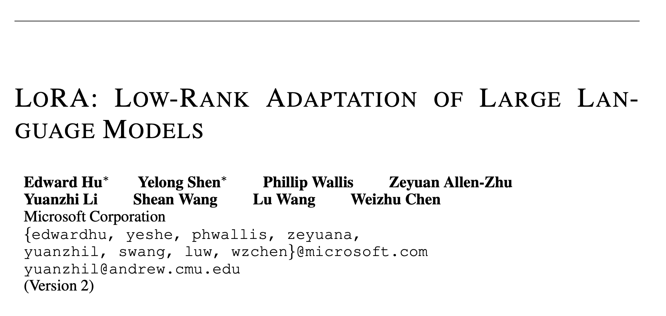
Low Rank Adaptation
Fine-tuning for the GPU poor :)

Slide 10
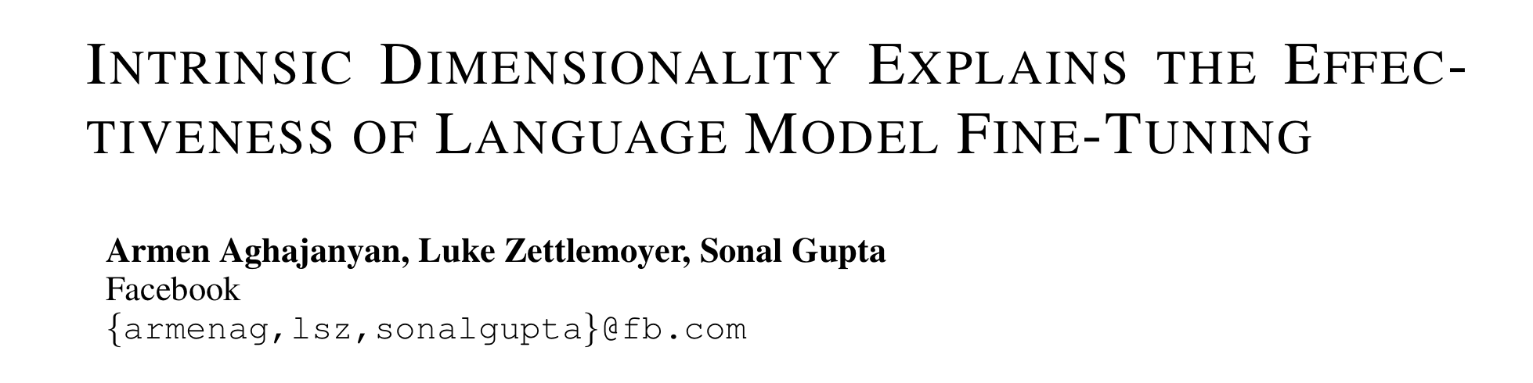
LoRA, Hu et al., 2021
Motivation

Slide 11
LoRA, Hu et al., 2021
Motivation
1. Do we need to fine-tune all the parameters?
2. How expressive should the matrix updates be?

Slide 12
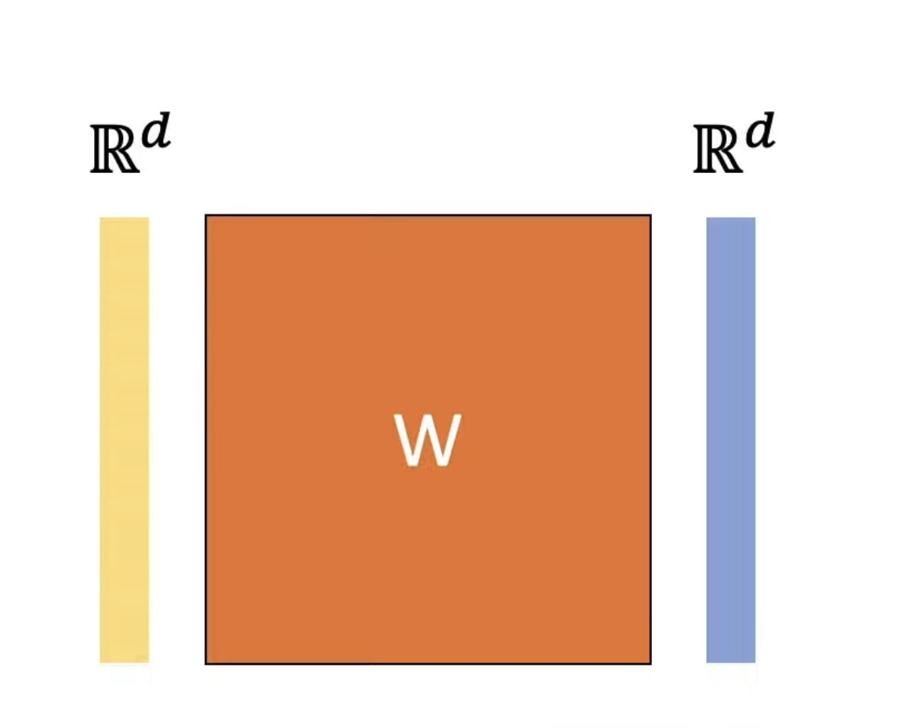
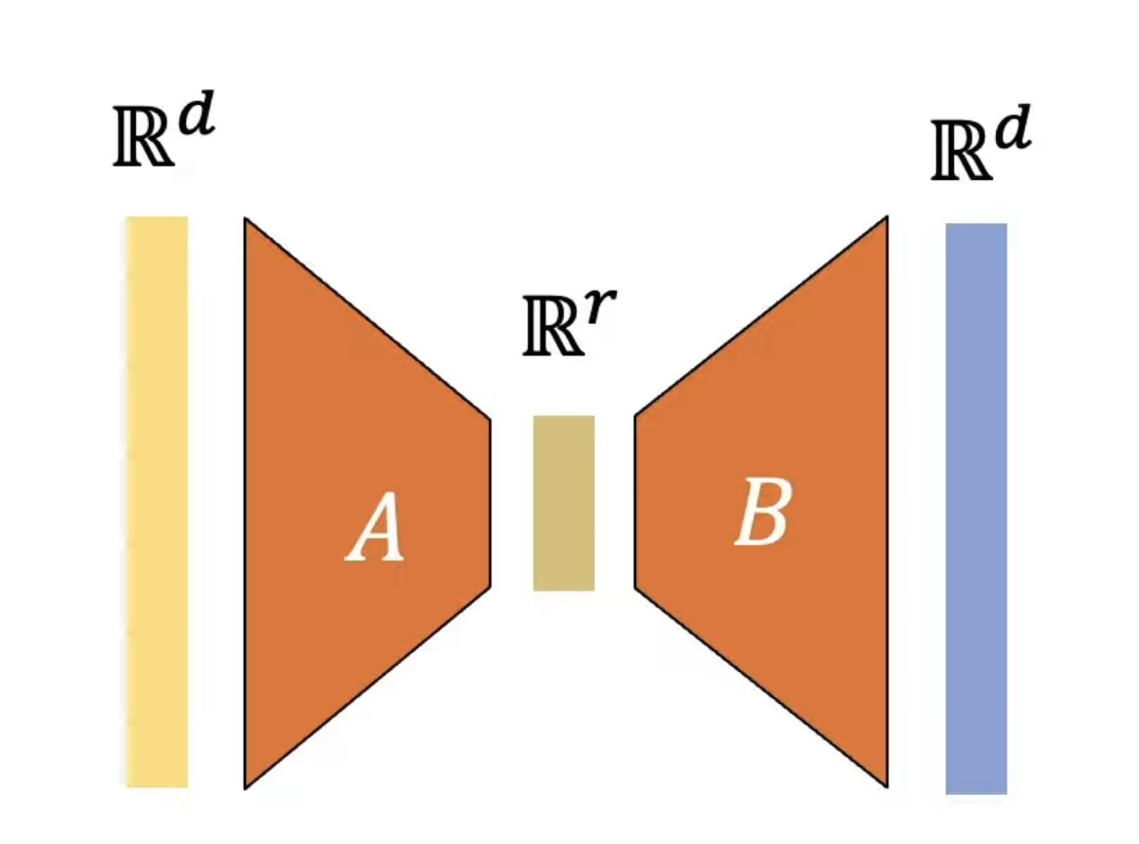
LoRA, Hu et al., 2021
How does it work?
https://youtu.be/DhRoTONcyZE?si=NCh9z594p4oIDGog

Slide 13
LoRA, Hu et al., 2021
How does it work?

Slide 14
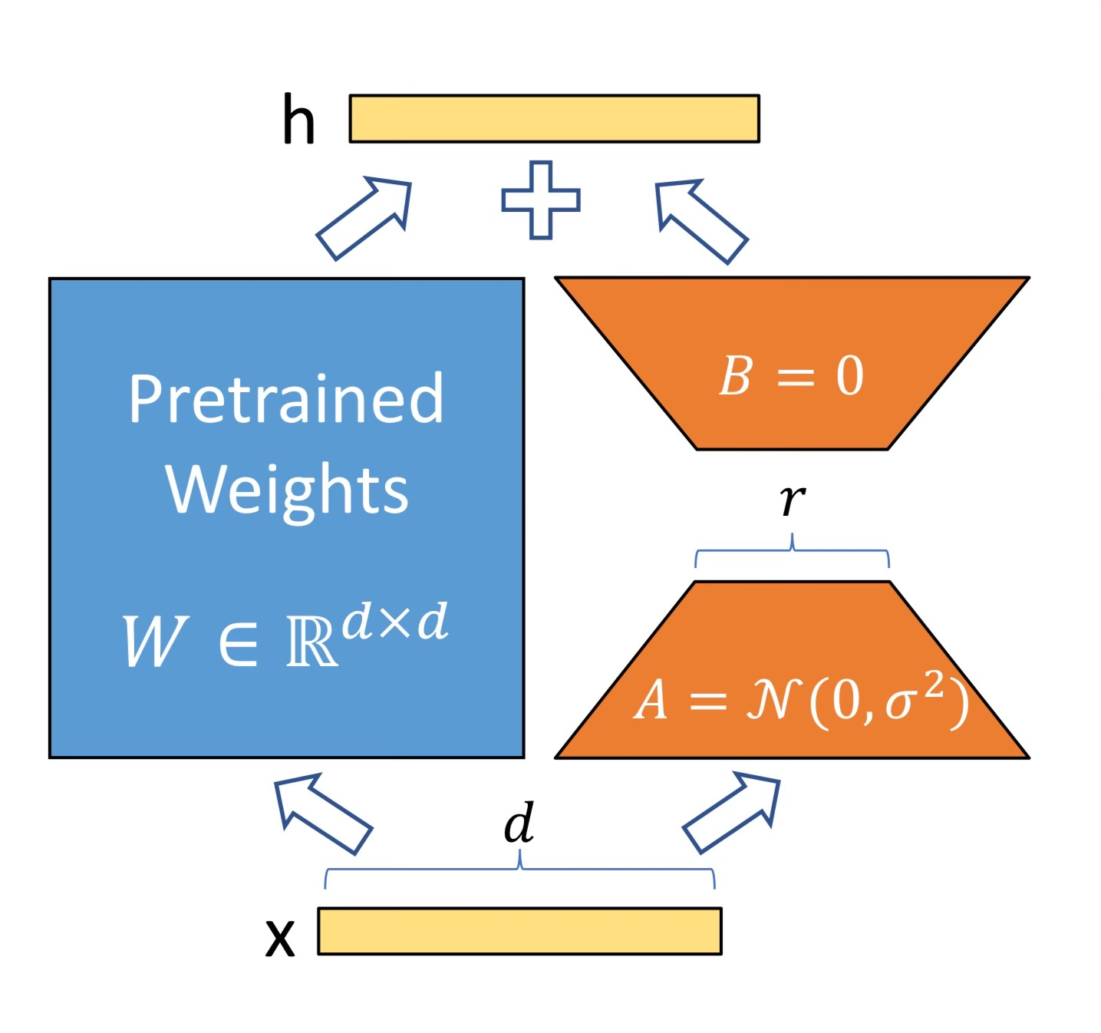
LoRA, Hu et al., 2021
How does it work?

Slide 15
LoRA, Hu et al., 2021
Does it work?
For GPT-3 175B, VRAM consumption is reduced from 1.2TB to 350GB.
With $r=4$, and only adapting $W_{Q}$ and $W_{V}$ , checkpoint size reduces from 350GB to 35MB. A 10,000x improvement.
There is a 25% speedup in fine-tuning time.

Slide 16
LoRA, Hu et al., 2021
Why is LoRA better?
A generalisation of full fine-tuning
No additional inference latency
Can dynamically choose adapters

Slide 17
LoRA, Hu et al., 2021
Limitations
Only adapt the transformer weight matrices
If you choose to dynamically change adapters, there is a latency hit.

Slide 18
Speeding up Inference

Slide 19
Speeding up Inference
KV Cache
During inference, Q for a token is computed only when its next token is being generated by the attention mechanism.
However, the K and V values are used repeatedly to generate each new token.
Caching KV vectors allows for linear inference time with respect to sequence length instead of quadratic!

Slide 20
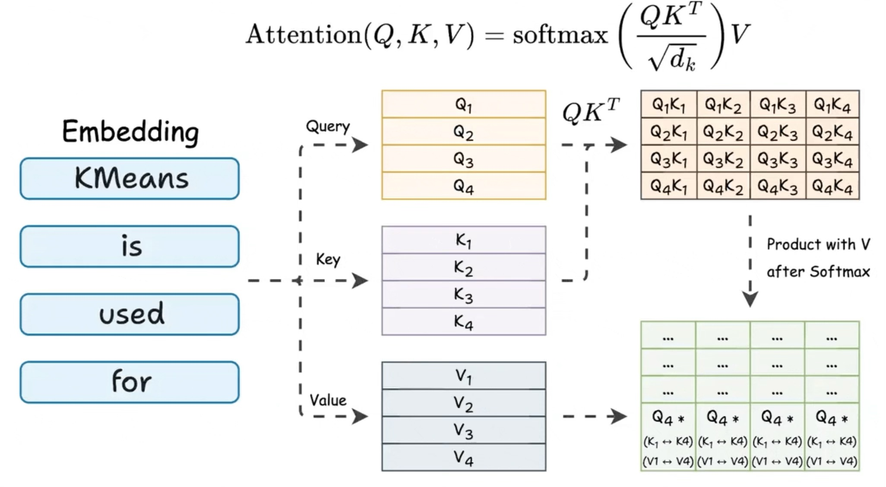
Speeding up Inference
KV Cache
https://www.dailydoseofds.com/p/kv-caching-in-llms-explained-visually/

Slide 21
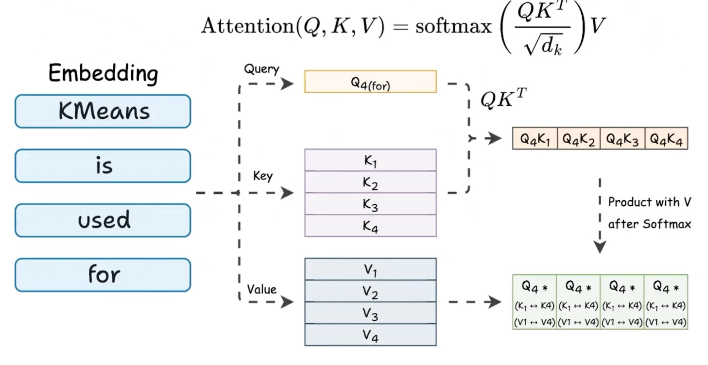
Speeding up Inference
KV Cache
https://www.dailydoseofds.com/p/kv-caching-in-llms-explained-visually/

Slide 22
Speeding up Inference
Speculative Decoding
Some tokens are easier to generate than others

Slide 23
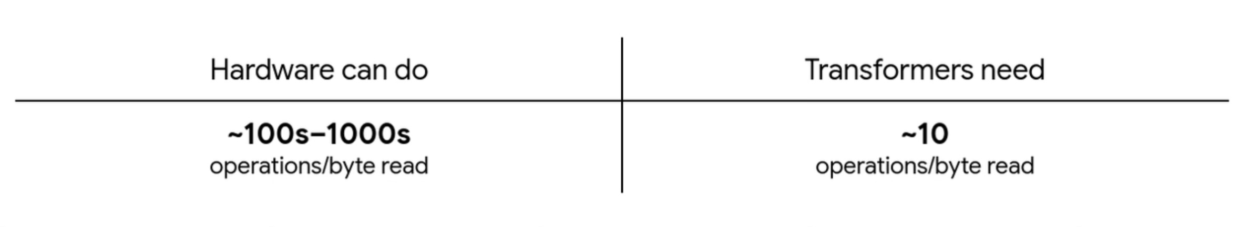
Speeding up Inference
Speculative Decoding
The bottleneck for LLM Inference is often memory.

Slide 24
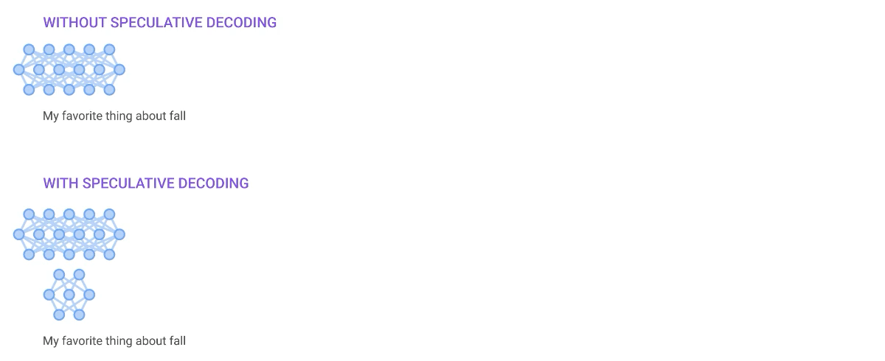
Speeding up Inference
Speculative Decoding
Use a small draft model for k tokens.
Verify the k tokens in parallel using our big LM.

Slide 25
Speeding up Inference
Flash Attention

Slide 26
Speeding up Inference
Distillation

